Slide 1
CAPSTONE PYTHON DATA ANALYSIS PROJECT
- ANIKET CHOWDHURY

Slide 2
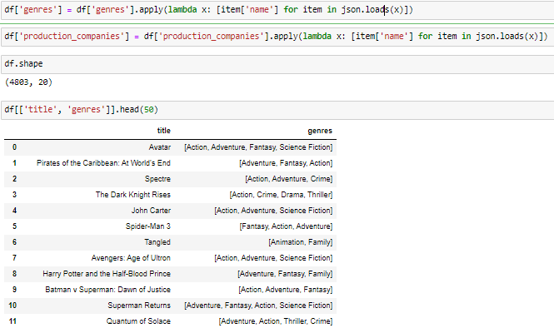
CODE & OUTPUT
INTERPRETATION
Read in the movie dataset CSV file into a Pandas dataframe. Process the JSON encoded columns (genres, production_companies) into lists for easier analysis. Display the first 50 rows of the title and genres columns to preview the data. The output shows the title and list of genres for the first 50 movies, with the JSON encoded data now converted to Python lists.

Slide 3
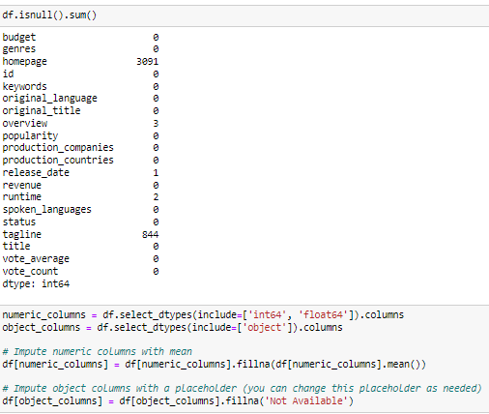
CODE & OUTPUT
INTERPRETATION
Check for null values in the dataframe. Impute numeric columns with mean and object columns with a placeholder value. The output summarizes null values across all columns before imputation. Several columns like homepage had many missing values. The imputation fills these to enable analysis.

Slide 4
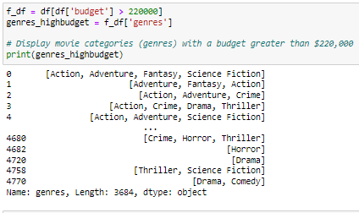
CODE & OUTPUT
INTERPRETATION
Filter movies with budget > $220 million. Print the genres for those high budget movies. The output shows genres for the 3684 movies with budget over $220 million. This filters specifically for higher budget blockbuster type movies.

Slide 5
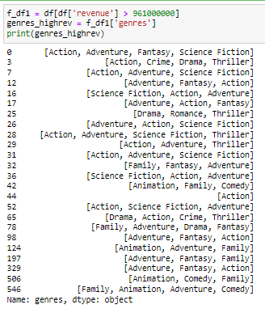
CODE & OUTPUT
INTERPRETATION
Similarly, filter movies with revenue > $961 million. Print the genres for those high revenue movies. The output extracts 25 very high grossing movies. We can analyze what genres tend to appear in highest grossing films.

Slide 6

CODE & OUTPUT
INTERPRETATION
Remove any rows with 0 budget or revenue, as they would skew analysis. The output prints the new number of rows after removing those with 0 in budget or revenue columns. This cleans invalid data.

Slide 7
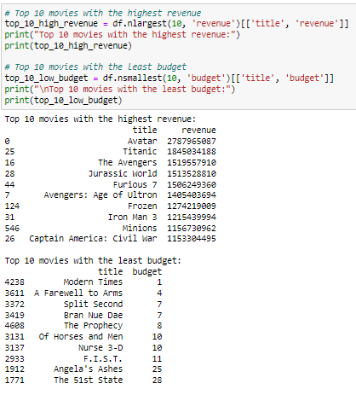
CODE & OUTPUT
INTERPRETATION
Find highest and lowest budget movies with nlargest and nsmallest. Print tables of top 10 highest and lowest budget titles and budgets. The outputs show the 10 movies with highest revenues (like Avatar) and 10 movies with lowest budgets (indie movies). This verifies dataset filters correctly.

Slide 8

CODE & OUTPUT
INTERPRETATION
Calculate correlation between budget and popularity. The output correlation of 0.43 shows moderately positive correlation, meaning higher budgets do tend to correspond to more popular movies.

Slide 9
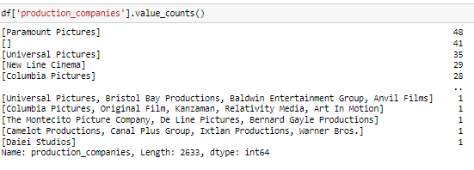
CODE & OUTPUT
INTERPRETATION
Print the production company counts. The output shows the number of movies per production company, with companies like Paramount Pictures being most common.

Slide 10
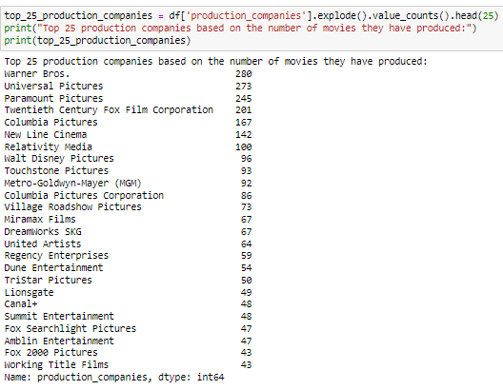
CODE & OUTPUT
INTERPRETATION
Print top 25 production companies by number of movies. The output extracts the 25 companies who have produced the most films, like Warner Bros, Universal, Paramount etc. Useful for analysis.

Slide 11

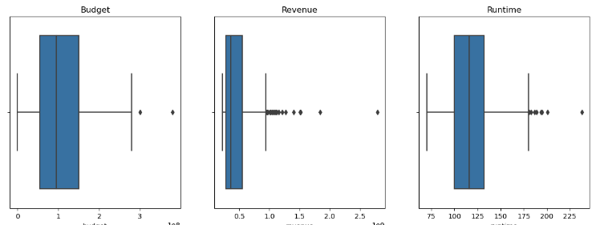
CODE & OUTPUT
INTERPRETATION
Sort movies by descending revenue. Take top 500 movies for analysis. This filters the dataset down to just very high revenue movies for more focused analysis.. Plot boxplots and central tendency for budget, revenue and runtime. The outputs visualize distribution and central tendency for those key columns on the top 500 movies. Helps identity outliers and patterns.

Slide 12
THANK YOU

